Slide 2
Agriculture plays a vital role in India's economy. 54.6% of the total workforce is engaged in agricultural and allied sector activates (Census 2011) and accounts for 17.8% of the country's Gross Value Added (GVA) for the year 2019-20 (at current prices). India is the second largest producer of wheat and rice, the world's major food staples. India is currently the world's second largest producer of several dry fruits, agriculture-based textile raw materials, roots and tuber crops, pulses, farmed fish, eggs, coconut, sugarcane and numerous vegetables
INTRODUCTION

Slide 3
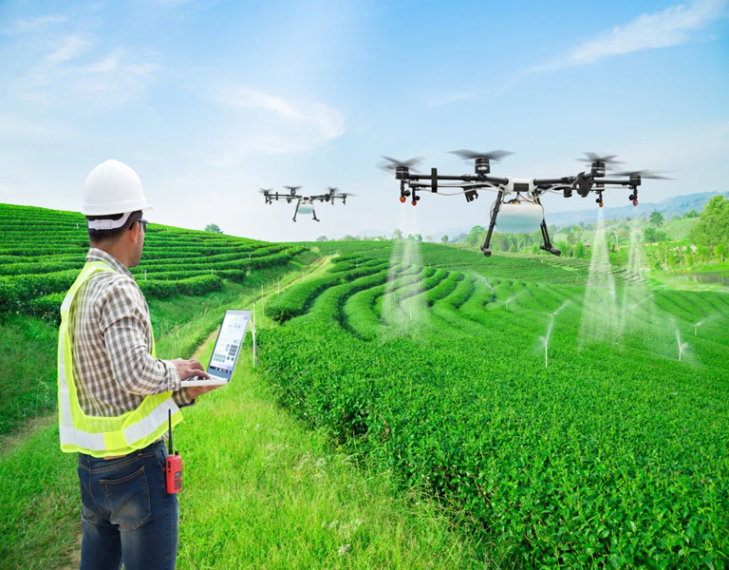
USES OF PESTICIDES
Pesticides are used to control various pests and disease carriers, such as mosquitoes, ticks, rats and mice. Pesticides are used in agriculture to control weeds, insect infestation and diseases. There are many different types of pesticides; each is meant to be effective against specific pests.

Slide 4
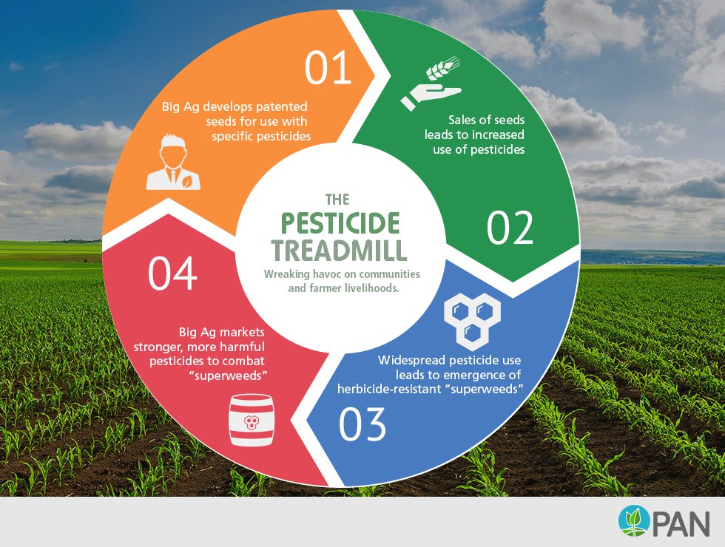
What pesticides are used in agriculture?
Examples of pesticides are fungicides, herbicides, and insecticides. Examples of specific synthetic chemical pesticides are glyphosate, Acephate, Deet, Propoxur, Metaldehyde, Boric Acid, Diazinon, Dursban, DDT, Malathion, etc.

Slide 5
What are the commonly used chemical pesticides and fertilizers?
The result for Commonly used chemical pesticides and fertilizers and their impact on human health and environment
Examples of specific synthetic chemical pesticides are glyphosate, Acephate, Deet, Propoxur, Metaldehyde, Boric Acid, Diazinon, Dursban, DDT, Malathion, etc.

Slide 6
What are the harmful effects of pesticides and fertilizers?
After countless studies, pesticides have been linked to cancer, Alzheimer's Disease, ADHD, and even birth defects. Pesticides also have the potential to harm the nervous system, the reproductive system, and the endocrine system
Adverse impacts of fertilizers are mainly caused by their excessive and inefficient use. This leads to nutrient losses to the environment and other adverse impacts, such as drinking water contamination and eutrophication of freshwater systems and coastal zones.

Slide 7
What are the three main types of pesticides in use?
Includes insecticides, herbicides and fungicides. The health hazard to humans and animals is mild with herbicides and fungicides, while greater with insecticides.

Slide 8
Why IoT is important in agriculture?
IoT based Smart Farming improves the entire Agriculture system by monitoring the field in real-time. With the help of sensors and interconnectivity, the Internet of Things in Agriculture has not only saved the time of the farmers but has also reduced the extravagant use of resources such as Water and Electricity.
Is IoT The future of agriculture?
The agriculture sector requires rapid technological transformation. This include IoT devices and systems, which helps farmers and producers find new efficiencies in land use, water use and crop management.

Slide 9
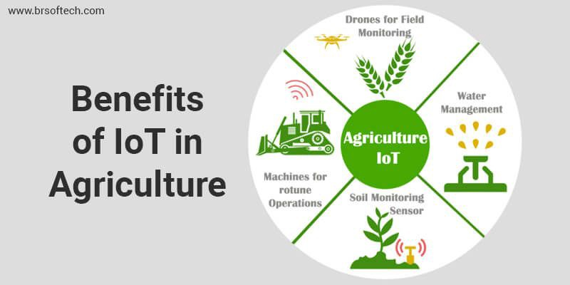
How IoT impacts agriculture?
With IoT, companies can enjoy benefits like better crop productivity and improved worker safety. They can use less fertilizer, water and pesticides. Because farmers can decrease the fertilizers and pesticides they use, there is less runoff into groundwater and rivers. This results in a lower impact on the ecosystem.
What are the challenges of IoT in agriculture?
The biggest challenges faced by IoT in the agricultural sector are lack of information, high adoption costs, and security concerns, etc. Most of the farmers are not aware of the implementation of IoT in agriculture.

Slide 10
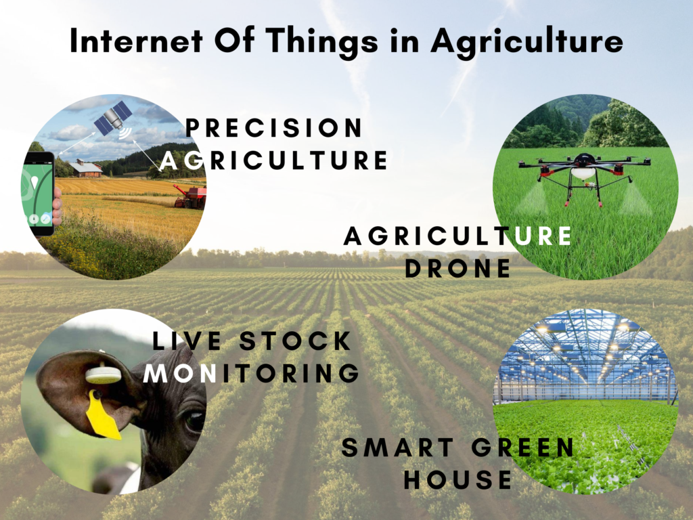
Significance of IoT in the Agricultural Industry

Slide 11
Which IoT sensors are used in agriculture?
There are many types of IoT sensors for agriculture as well as IoT applications in agriculture in general:
1.Monitoring of climate conditions.
Greenhouse automation.
Crop management.
Cattle monitoring and management.
Precision farming.
Agricultural drones.
Predictive analytics for smart farming.

Slide 12
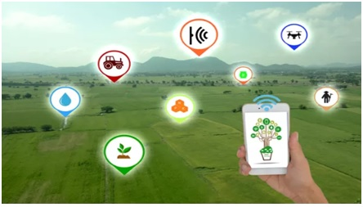
Which sensor is used in agriculture?
Electrochemical Sensors provide key information required in precision agriculture: pH and soil nutrient levels. Sensor electrodes work by detecting specific ions in the soil. Currently, sensors mounted to specially designed “sleds” help gather, process, and map soil chemical data.
List of Agriculture Sensors, Advantages of Agriculture Sensors

Slide 13
Can be effectively used in crop planning and its management.
A comprehensive weather based farm advisory is an interpretation of how the weather parameters, in future and present will affect crops, livestock and farm operations and, suggests actions to be taken.
The Advisory Services will be more effective if they are given in simple and local language that farmers can understand it.
In order to make the Agro-Met Advisory Services more successful and continuous process, it is to be supported with:
agro meteorological database,
crop conditions,
real time weather, research results on crop-weather relationships, and
skilled manpower in multi- disciplinary resources and users interface.
Weather forecasts are of four types, viz., now casting (4 to 5hrs), short range forecast (valid for 48 hours), medium range (valid for 5 days to a week) and long-range or seasonal forecast (valid for month to season).

Slide 14
Training should be organized on:
Climatologically Analyses particularly of rainfall and temperature
Weather forecasting and services specific to agriculture
Micro-meteorology
Crop water use and irrigation management
Crop simulation modelling
Role of Meteorology in Crop protection, including pests and diseases modelling
Weather, Climate and Livestock, poultry and fish production
Climate Change and Agriculture
Geographic Information Systems and Remote Sensing in Agro meteorology.

Slide 15
THANK YOU

